Slide 1
Factorising by grouping

Slide 2
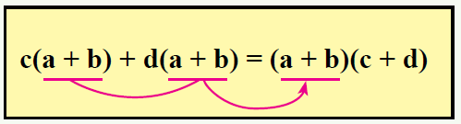
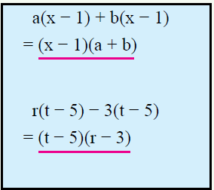
EQ: how do we factorise by grouping?
Sometimes the highest common factor is inside brackets.

Slide 3
Factorizing by grouping
You can easily tell when you’ve got one of these because there are (almost always) FOUR TERMS !!!
Example 1
Factorise 2a – 4b + ax – 2bx
STEP 1 – split it into “2 and 2”
= 2a – 4b + ax – 2bx
STEP 2 – factorise each pair separately by taking out a common factor
= 2(a – 2b) + x(a – 2b)
Aim to get the same expression in both brackets
STEP 3 – take out the (a – 2b) as a common factor
= (a – 2b)(2 + x)...ans!!

Slide 4
Example 2
Factorise xy + 5x – 2y – 10
STEP 1 – split it into “2 and 2”
= xy + 5x – 2y – 10
STEP 2 – factorise each pair separately by taking out a common factor
Note the sign change in the 2nd bracket!!
– 2 × 5 = – 10
= x(y + 5) – 2 (y + 5)
STEP 3 – take out the (y + 5) as a factor
= (y + 5)(x – 2) ans!!

Slide 5
Example 3
Factorise x² – x – 5x + 5
STEP 1 – split it into “2 and 2”
= x² – x – 5x + 5
STEP 2 – factorise each pair (common factor)
Sign change in the 2nd bracket again!!
= x(x – 1) – 5 (x – 1)
STEP 3 – take out the (x – 1) as a
factor
Brainstorm!!
You can tell you’re on the right track if each bracket is the same!!
= (x – 1 )(x – 5) ans!!

Slide 6
Practice:
Page 74 Dwyer

